Slide 1
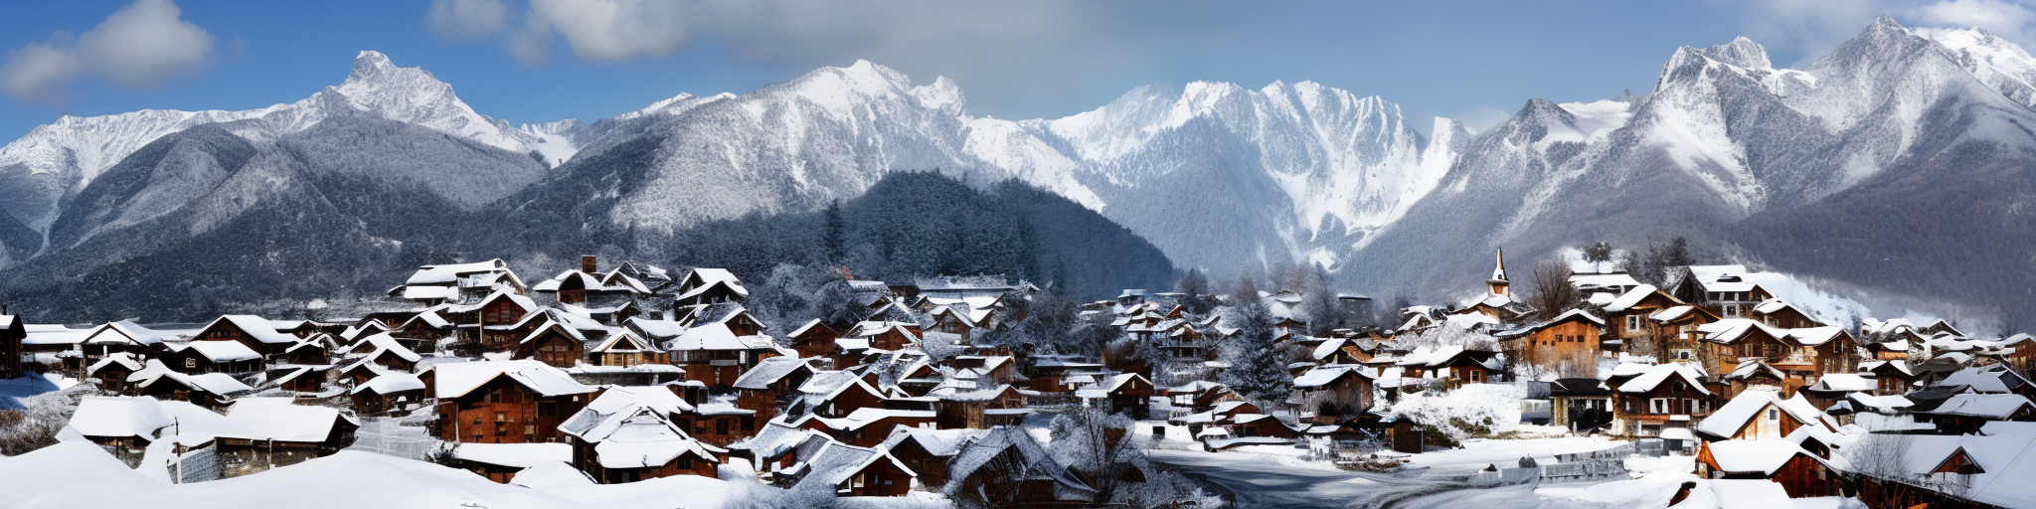
Panorama generation with region based control
Based on MultiDiffusion: Fusing Diffusion Paths for Controlled Image Generation (ICML 2023)
Presenter: Yinghao Zhang, Keling Yao, Silong Yong

Slide 2
Content
Recap: Combine: region-based + panorama
Showcase bad results
Key takeaway
===========================================
Our model Design
===========================================
Qualitative results
Analysis

Slide 3
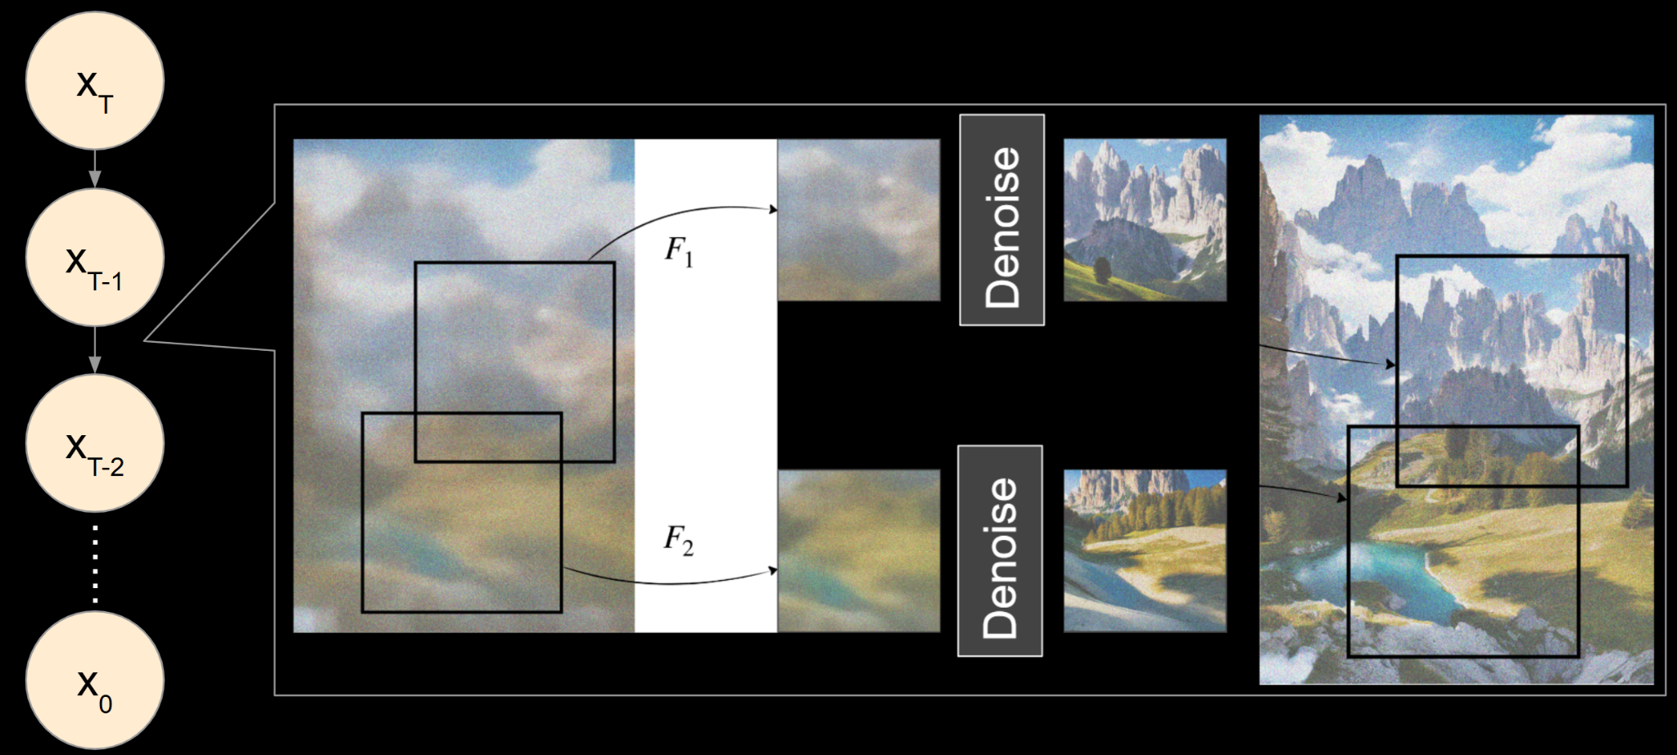
Recap: MultiDiffusion
Take average!
Task: generate panorama or region-based images using pre-trained diffusion models

Slide 4

Recap: MultiDiffusion
Task: generate panorama or region-based images using pre-trained diffusion models
“A sunny day after the snow, two dogs sitting side by side, a German Shepherd dog on the right, a Husky dog on the left”

Slide 5

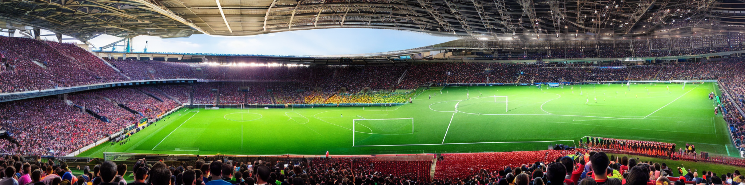
Panorama + Region-based? Not working well…
“A stadium holding a soccer game, full of people.”
Mask: “a green field”

Slide 6
Takeaway from MultiDiffusion
In a denoising step, each patch is denoised independently -> denoise into different directions -> inconsistency

Slide 7
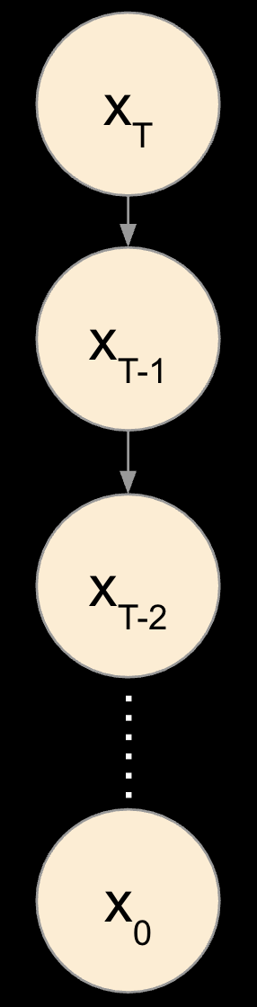
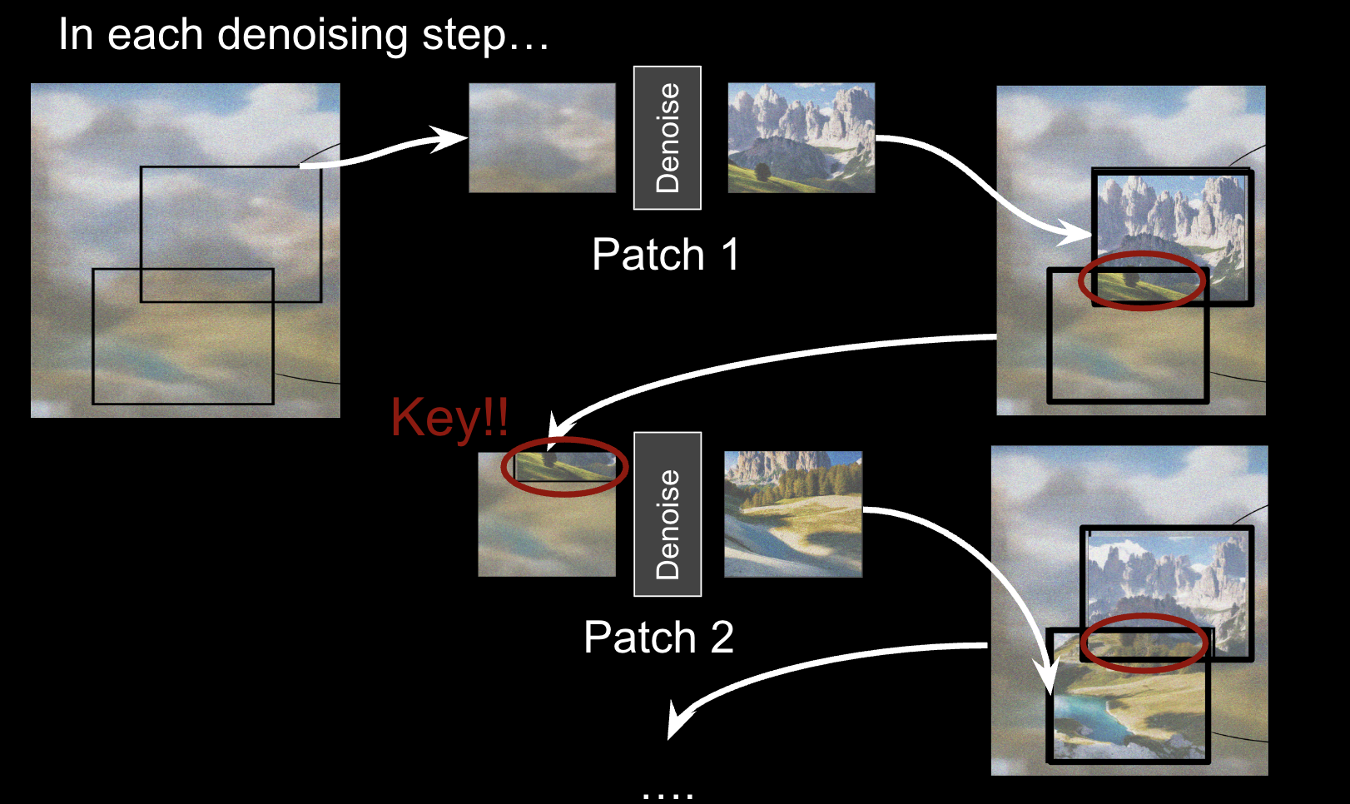
Model Design 1: from independent to dependent patch denoising → Improve overlap consistency
Notes:
In our proposed model, we have made 2 essential model design choices.
In previous baseline model, each patch denoise independently and then we average the overlap region.
first improvement is that each patch denoise will follow a sequential execution rather then parallel execution. Which means after patch 1 have denoised, we use the overlapping region as part of the initial patch 2, just as the red circle shown here.
In this way when patch 2 are denoising, the overlap region will provide some information about surrounding patches. Future patches.
We hope this dependent patch denoising will improve the overall consistency of the panorama, especially the overlap region.

Slide 8
Model Design 2: From left-to-right sliding to center-to-side sliding
→
Before
After
“A stadium holding a soccer game, full of people.”
Notes:
The second design choice we made is about how we process the sliding of patches.
In baseline model, the sliding is always left to right.
But as shown in this greenfield example, the most inconsistent region lay in the center. Which make sense, because the layout of whole image usually depends on the center.
So we simple change the sliding from left to right to center to side and highlight the importance of the middle patch.

Slide 9

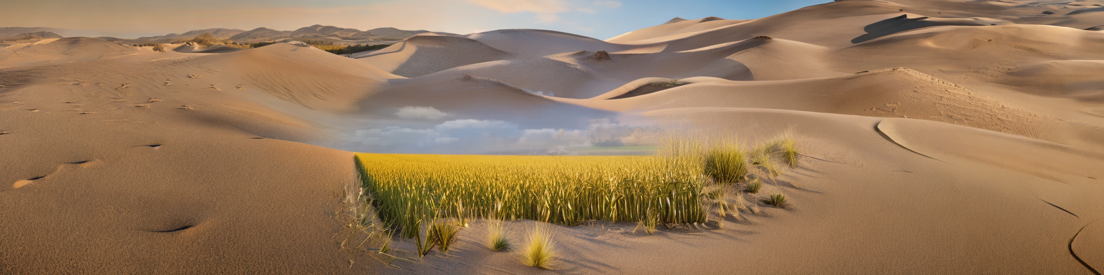
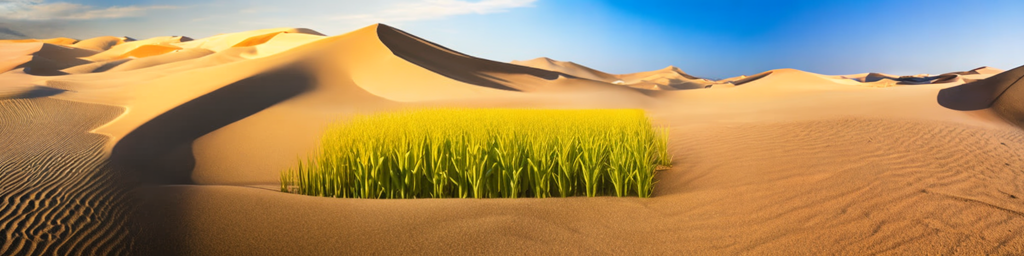
Qualitative Results
Better region mask following & blending
a vast desert landscape with rolling sand dunes, scattered dry vegetation; a vast corn field stretching to the horizon, golden stalks swaying in the breeze

Slide 10

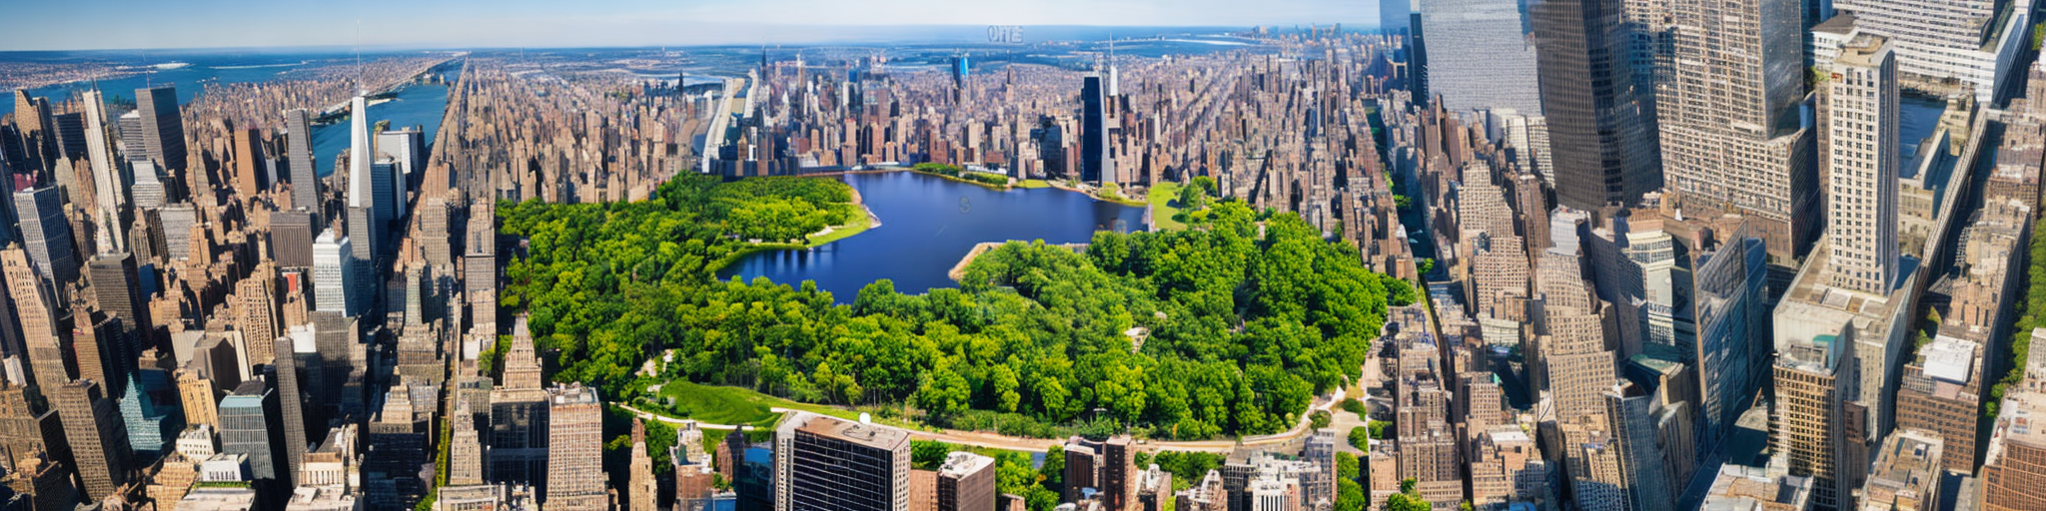
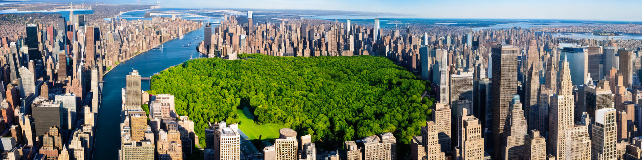
Qualitative Results
Better viewpoint consistency & blending
aerial view of Manhattan, New York City, dense skyscrapers, grid-like street pattern; aerial view of a forest park, lush green trees, small lakes, recreational areas, dense canopy, detailed foliage

Slide 11
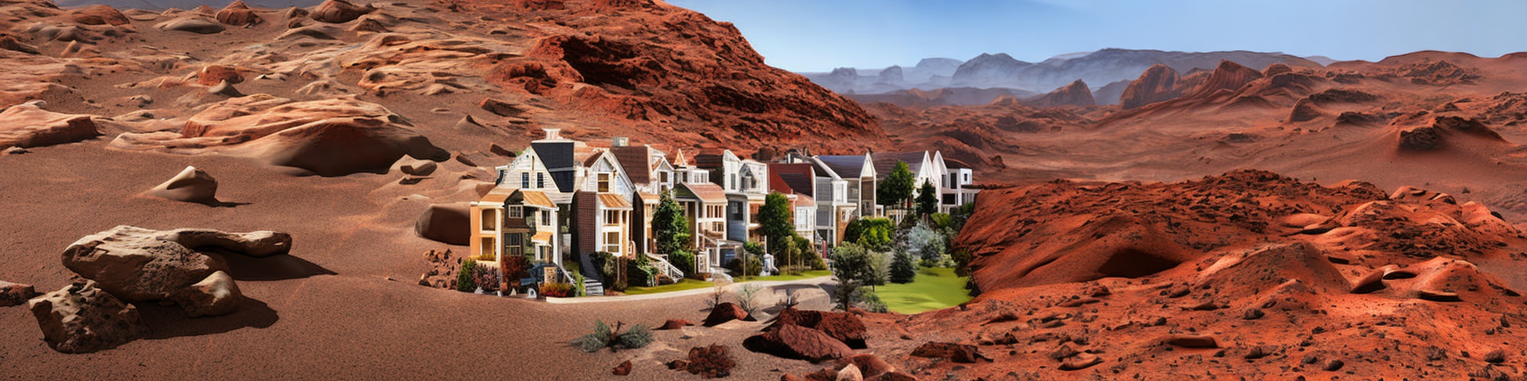
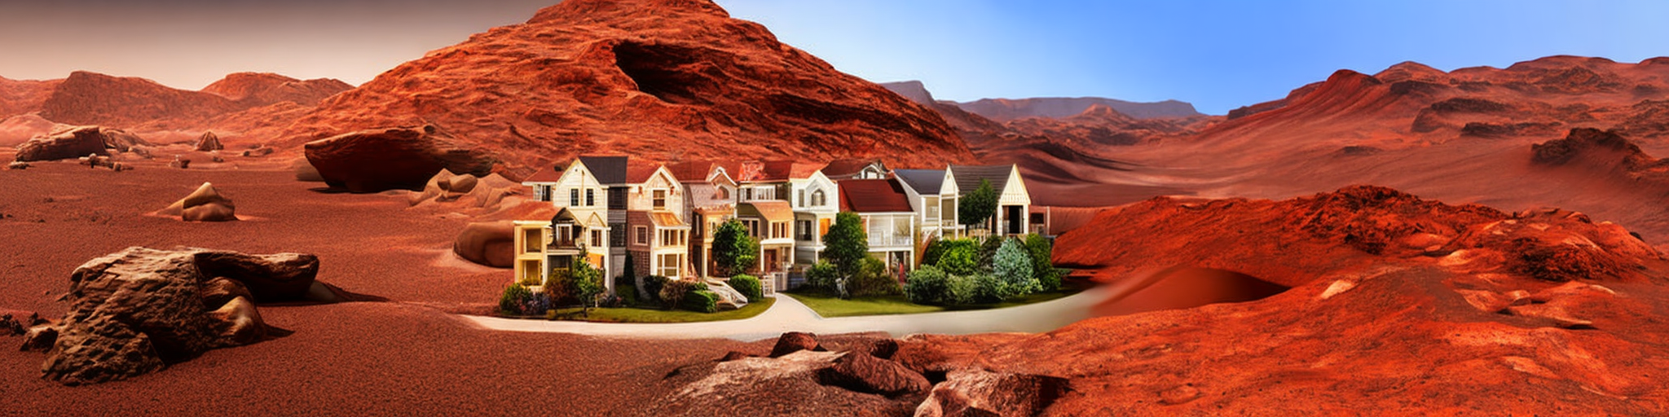
Qualitative Results
Better viewpoint consistency but denoise too much
a vast Martian landscape with red rocky terrain; realistic and highly detailed rows of houses with detailed architecture

Slide 12
Takeaway
Center-to-side sliding helps with patch-wise consistency by deciding the overall style
Patch-dependency in denoising steps helps with understanding the neighbor content & following the region guidance
May lead to over-smooth results

Slide 13
Thank You!
Notes:
Thank you for your attention! We are happy to take any questions.

Slide 14
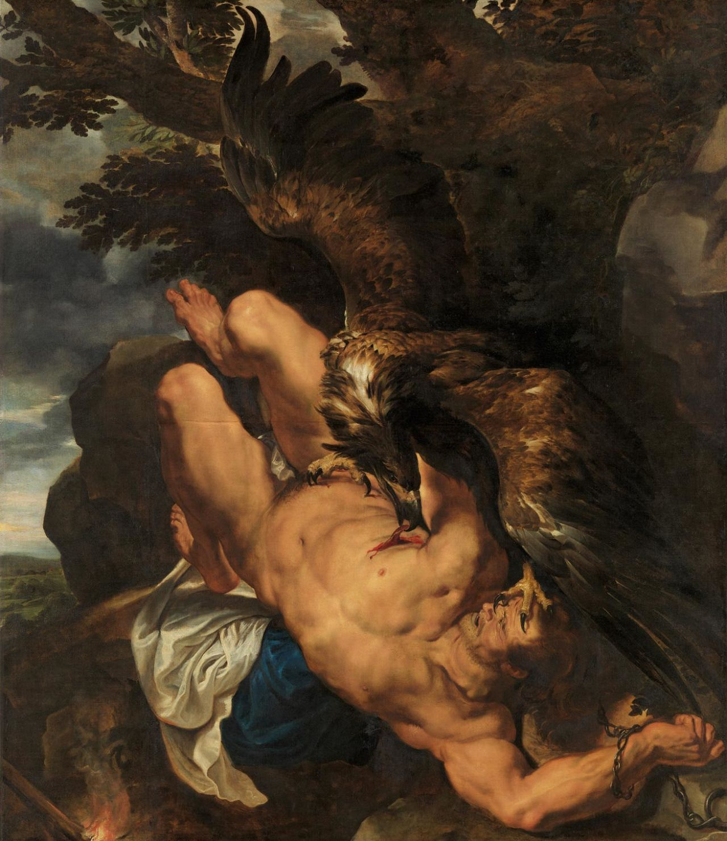
Prometheus Bound
🎨Frans Snyders
🎨Peter Paul Rubens
Source: Wikipedia - Prometheus Bound (Rubens)

Slide 15
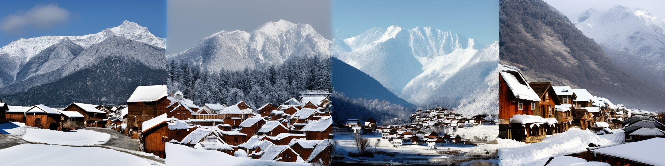
Collaborative image generation?
Goal: generate high-resolution images, using pre-trained low-resolution diffusion models, without any training
Idea 1:
🖼️ | 🖼️ | 🖼️ | 🖼️

Slide 16
Idea 2: overlapping patches
🖼️
Text input
?
🖼️
Diffusion
Average?
🖼️

Slide 17
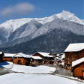
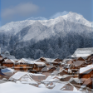
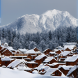
Idea 2: not work…
Average

Slide 18
Idea 3: MultiDiffusion
❌ Generate patches, then average
✅ Average inside each denoising step

Slide 19
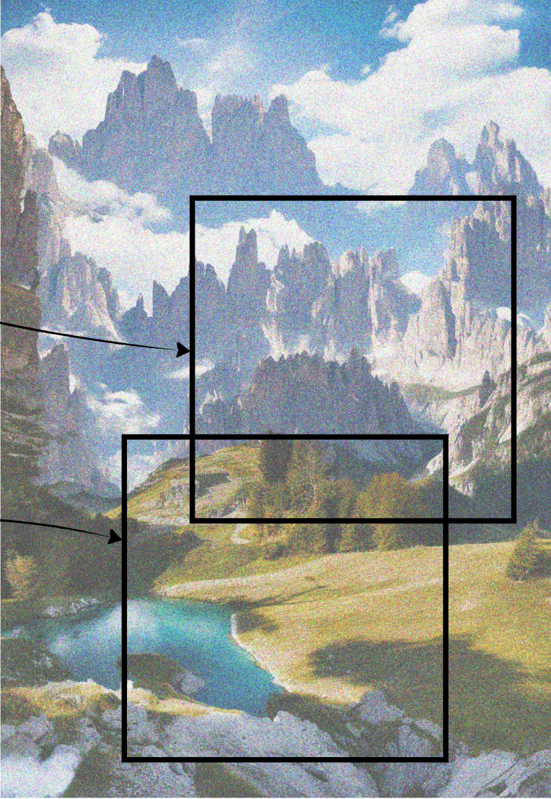
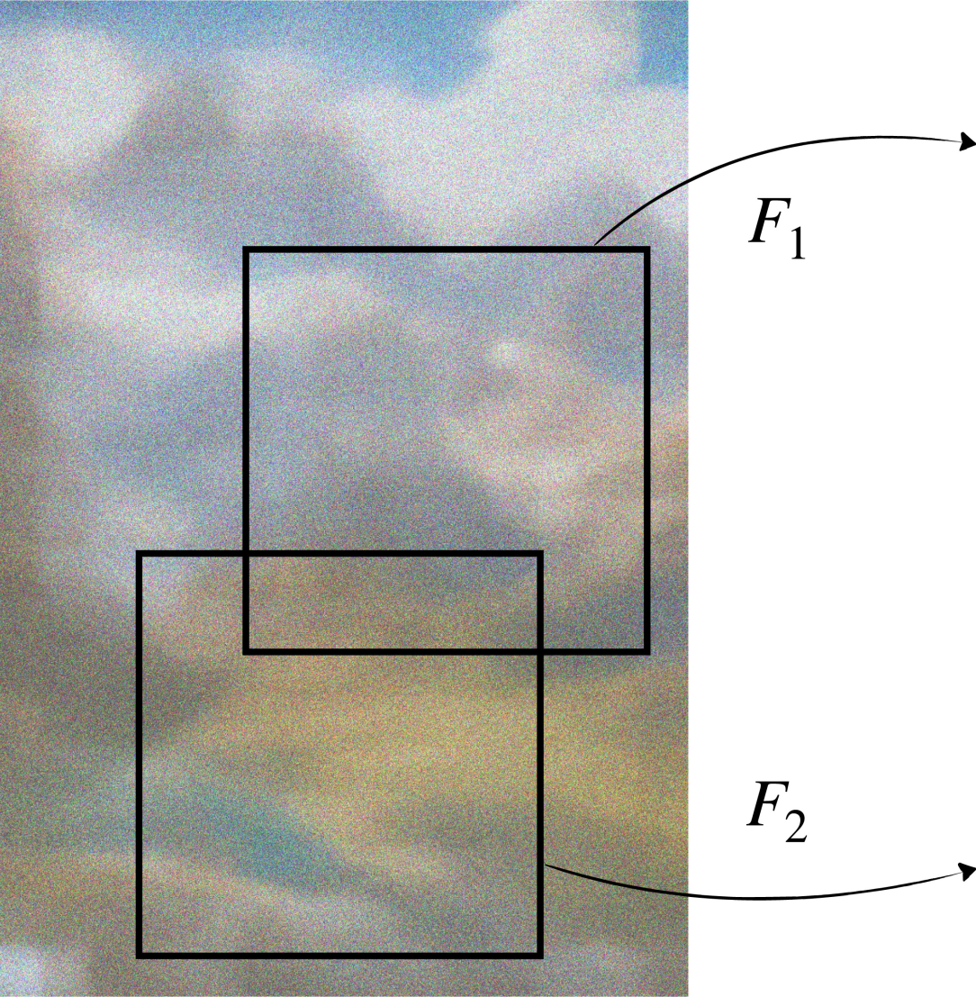
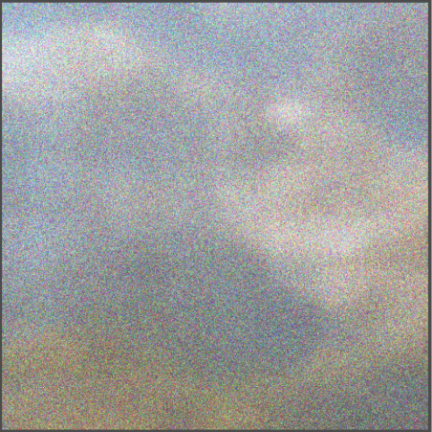
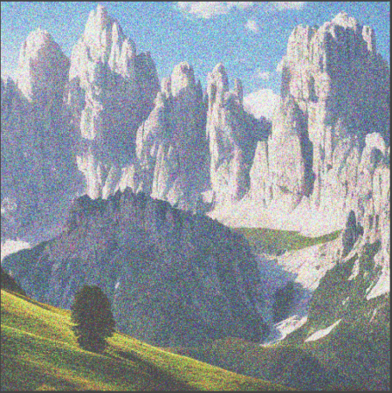
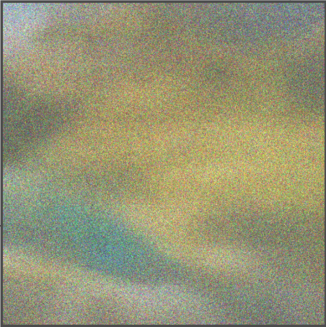
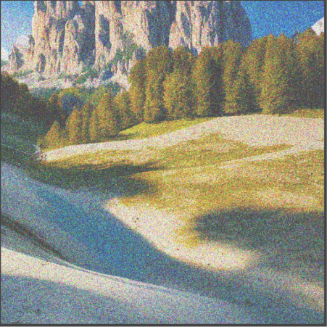
Idea 3: MultiDiffusion
In each denoising step…
Denoise
Denoise

Slide 20
Idea 3: MultiDiffusion
512x2048
Backbone: Stable-Diffusion-2, 512x512

Slide 21
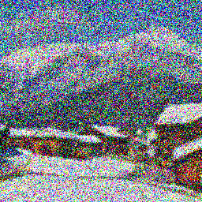
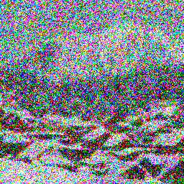
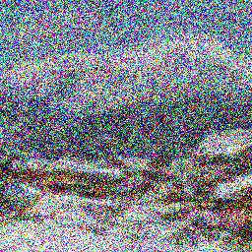
Analysis - why does this work?
Idea 2 averaging final images:
Average
Idea 3 averaging noised images:
Average

Slide 22
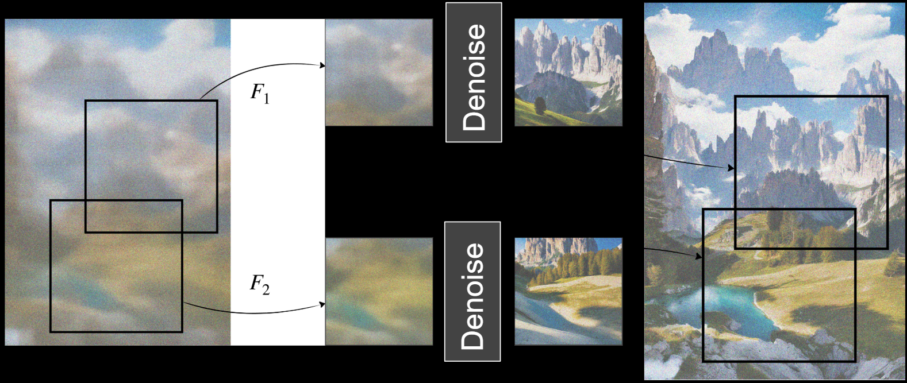
Pipeline
x_{T}
x_{T-1}
x_{T-2}
······
x₀

Slide 23
Pipeline
x_{T}
x_{T-1}
x_{T-2}
······
x₀

Slide 24
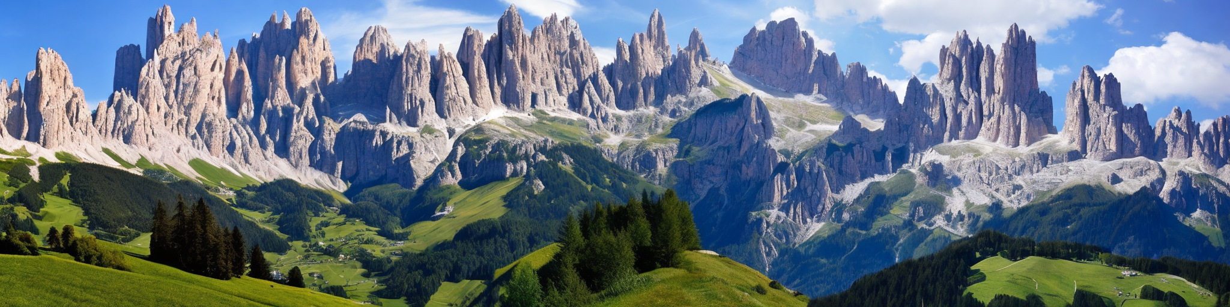
Results
“a photo of the dolomites”
512x2048

Slide 25
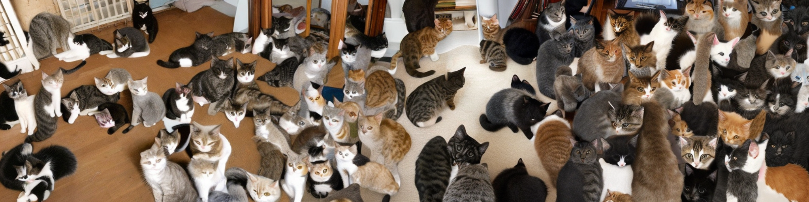
Results
“a room full of cats”
512x2048

Slide 26
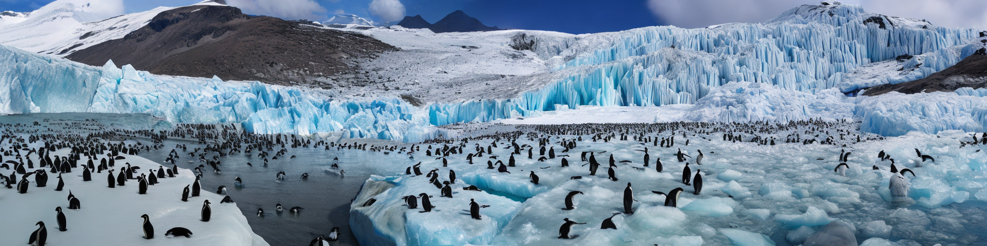
Results
“A giant glacier with dozens of penguins”
512x2048

Slide 27
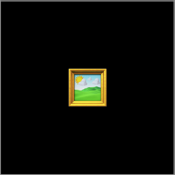
Another Angle!!
Panorama:
Fuse Patches
Spatial fusion
Region based text2image:
Fuse semantic region
Semantic fusion
Notes:
To summarize what Yinhao has introduced, this paper have give us some inspiration on how to generate high resolution images by fusion overlap patches together. And we can say this is a kind of spatial fusion.
On the other hand, we can also follow the same pipeline and change the dimension of the fusion. For example, in the paper, the author also introduce another downstream tasks, which is the region based text2 image generation. In the task, we are trying to fuse the semantic region together and create high quality images that have the desired content in each specific region. So, I would call it semantic fusion.

Slide 28
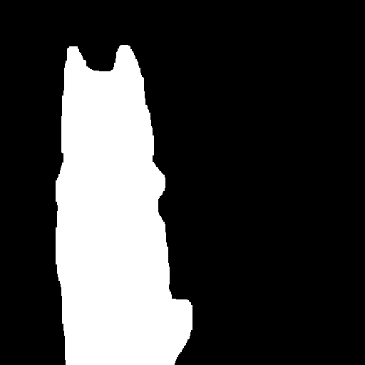
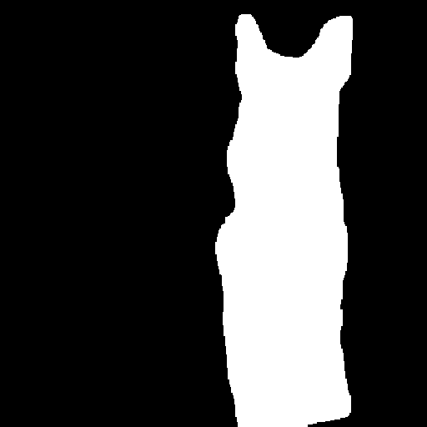
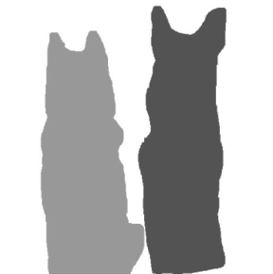
Region based text2image
MultiDiffusion
Masks
Prompt
“a Husky dog”
“a German Shepherd dog”
“A sunny day after the snow, two dogs sitting side by side, a German Shepherd dog on the right, a Husky dog on the left”
“A sunny day after snow”
Notes:
Let’s start with introducing what is region based text2image generation.
For this type of generative tasks, we need to provide both text instructions and precise masks as a prior to the model.
In this paper, Multidiffusion requires more strict input, we need separate masks and text prompt for each foreground objects and background.
For example,...
sha/ per/ de

Slide 29
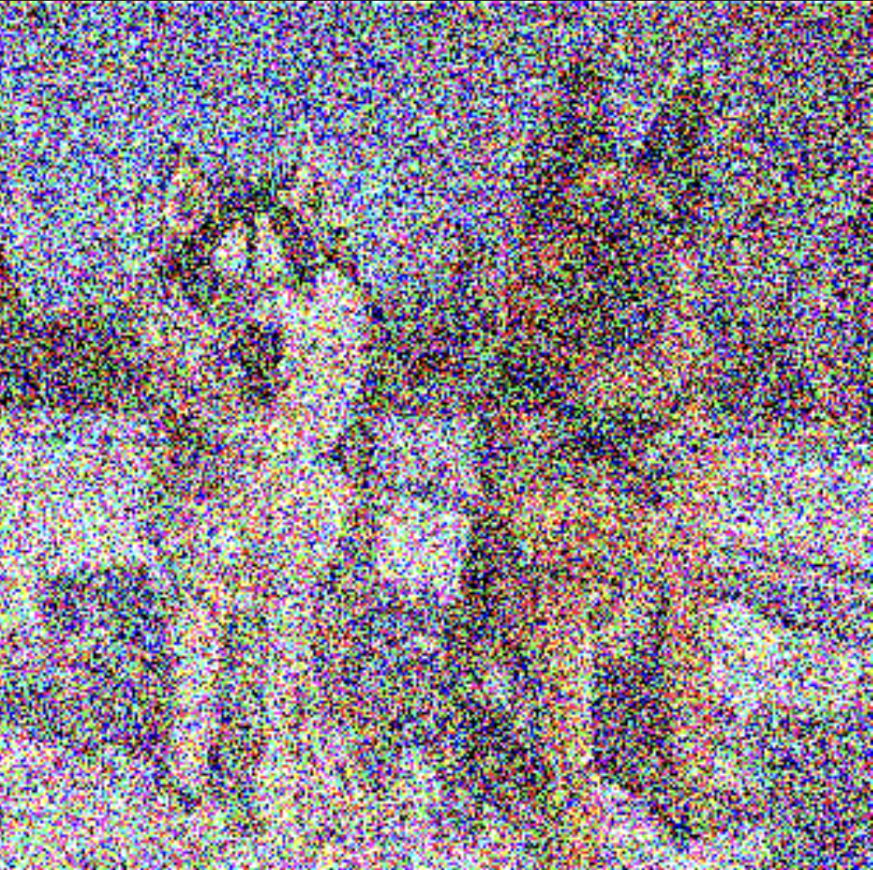
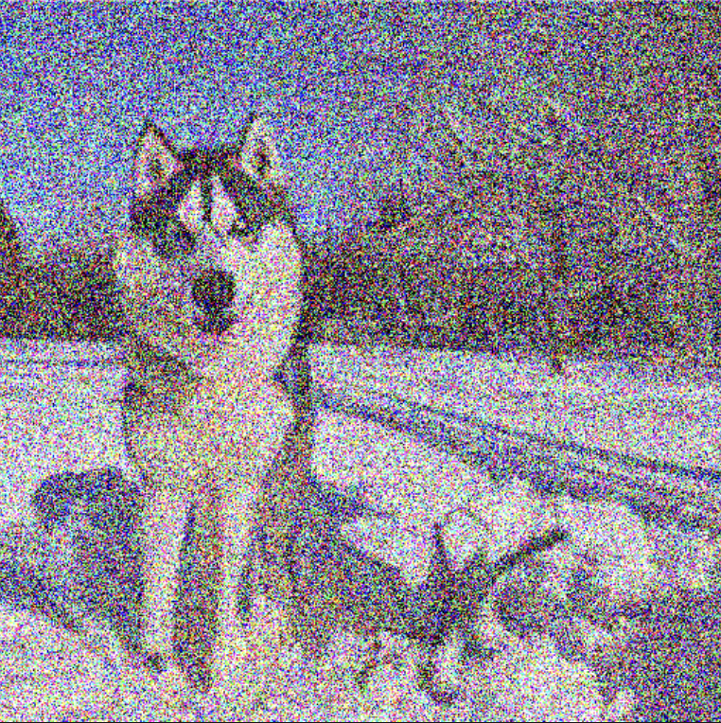
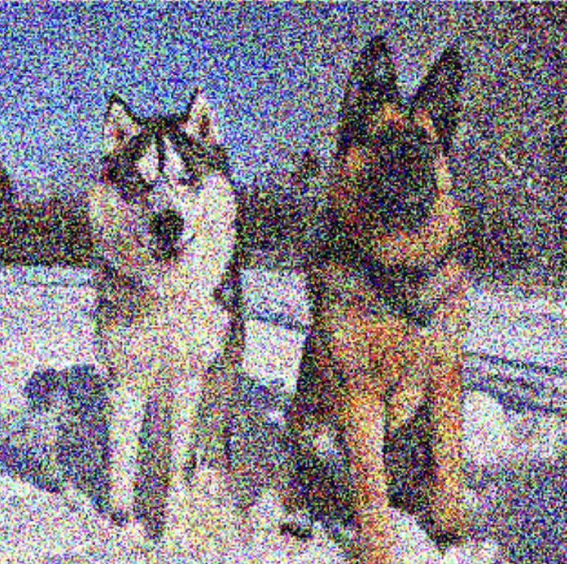
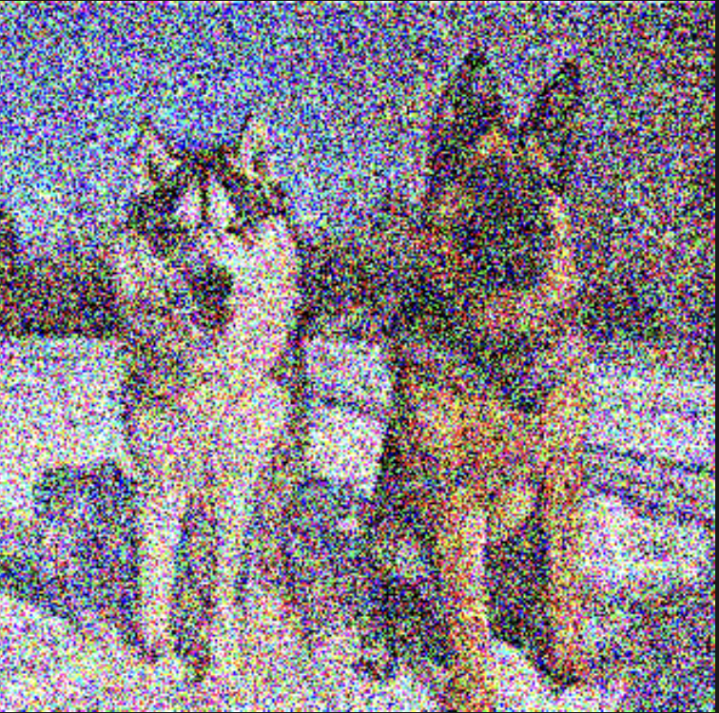
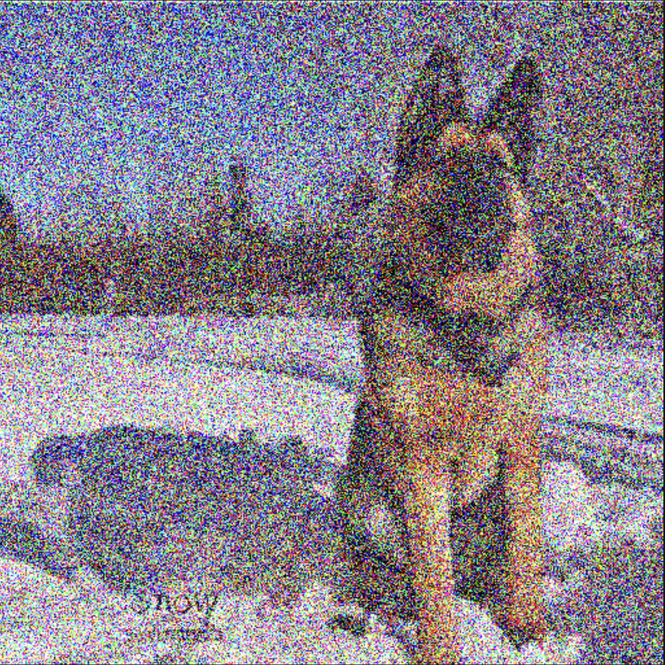
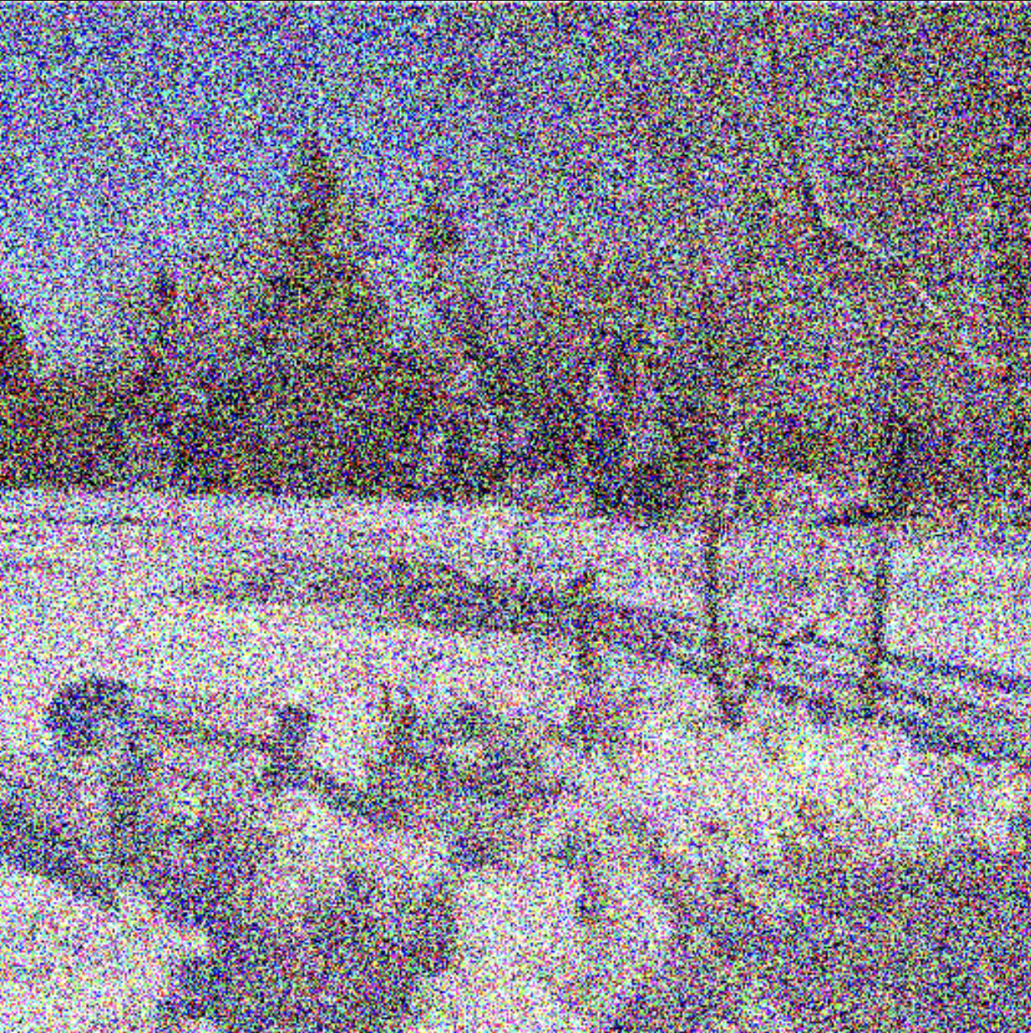
Region based text2image
In each denoising step…
denoise
“a Husky dog”
Weighted Average
By masks
denoise
“a German Shepherd dog”
denoise
“A sunny day after snow”
Notes:
So how multidiffusion deal with this tasks without any training?
In each denoising steps, we are following standard diffusion process.
First, we use SD with the a specific text prompt to predict toward text guidance. For example…
And we use SD in parallel for each foreground objects and background separately. Then we will have 3 denoised latent embedding that are guidenced by different text prompt.
And Finally, we use masks and doing weighted average for each branch to fuse the latent space together.
It is very similar to what yinhao have introduced in paronma. Instead of use SD to generate different patches and fuse them together by averaging, here We use SD to generative different objects and background and fuse them together by weighted masks

Slide 30
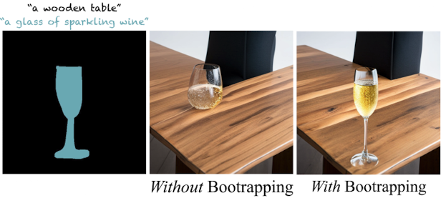
How to predict Semantic noises with strong masks boundary?
Problem: Post-denoising mask alignment
Bootstrapping: Fidelity to tight masks
Notes:
But there is the problem with this pipeline. We can see from this example, when the front ground text prompt is a glass of sparkling wine
The background prompt is a wooden table. We can see the results that the model successfully generates the glass in some location inside the mask but does not have the precise layout as the desired.
This is because the masks constraints are used after the SD denoise step to fuse the latent space together and there are no strong guarantee that SD denoise step will follow the shape of the mask because the SD only take the text prompt as input.
So, here is the question, how to predict Semantic noises with strong masks boundary?
In this paper, the author introduce a bootstrapping phase during the denosie step to have the object stay close to the tight mask.
• Why Bootstrapping?
• Ensures both global layout consistency and local region accuracy in diffusion models.
• Prevents early-stage mask constraints from disrupting natural image structure.
• Helps mask-guided generation align better with prompts.

Slide 31
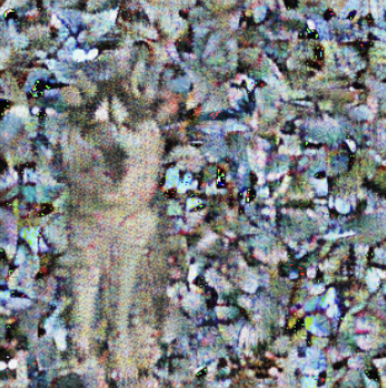
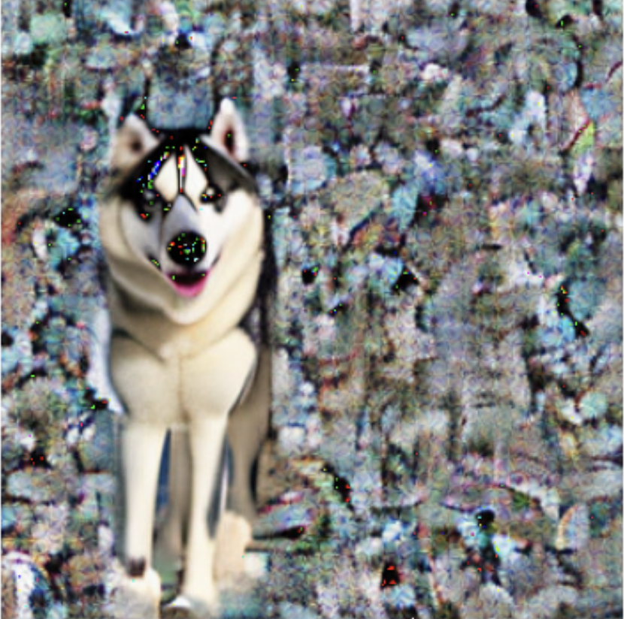
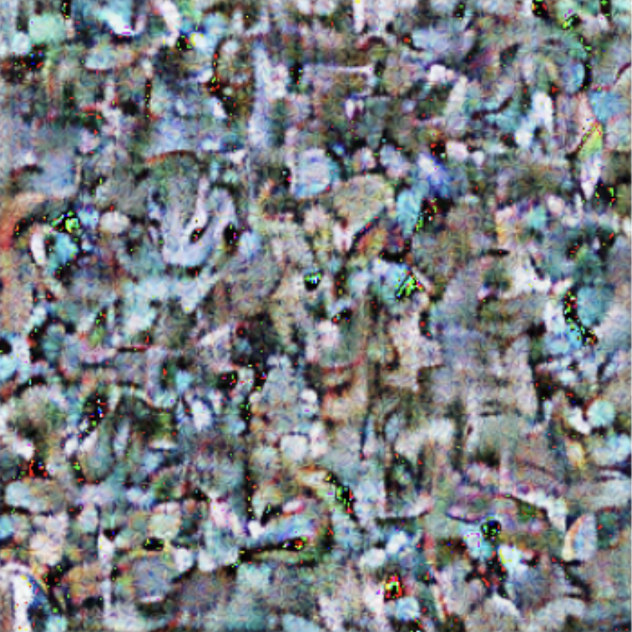
Bootstrapping: Fidelity to tight masks
Before T_{init} …
After T_{init} …
denoise
“a Husky dog”
“a Husky dog”
denoise
strong boundary!
Random background
Notes:
Here is how the bootstrapping works.
During the denoise process, we have a hyperparameter T_init, this is the time when we are switch to bootstrapping phase.
Before T_init, the denoise step is straightforward, just with the current latent embedding and the text prompt.
After T_init, we will use mask to query original latent embedding and replace the background of the original embedding with a random background. And we are denoising on this new latent space. In this way, we are give strong geometry prior to the SD to control the generation process.

Slide 32
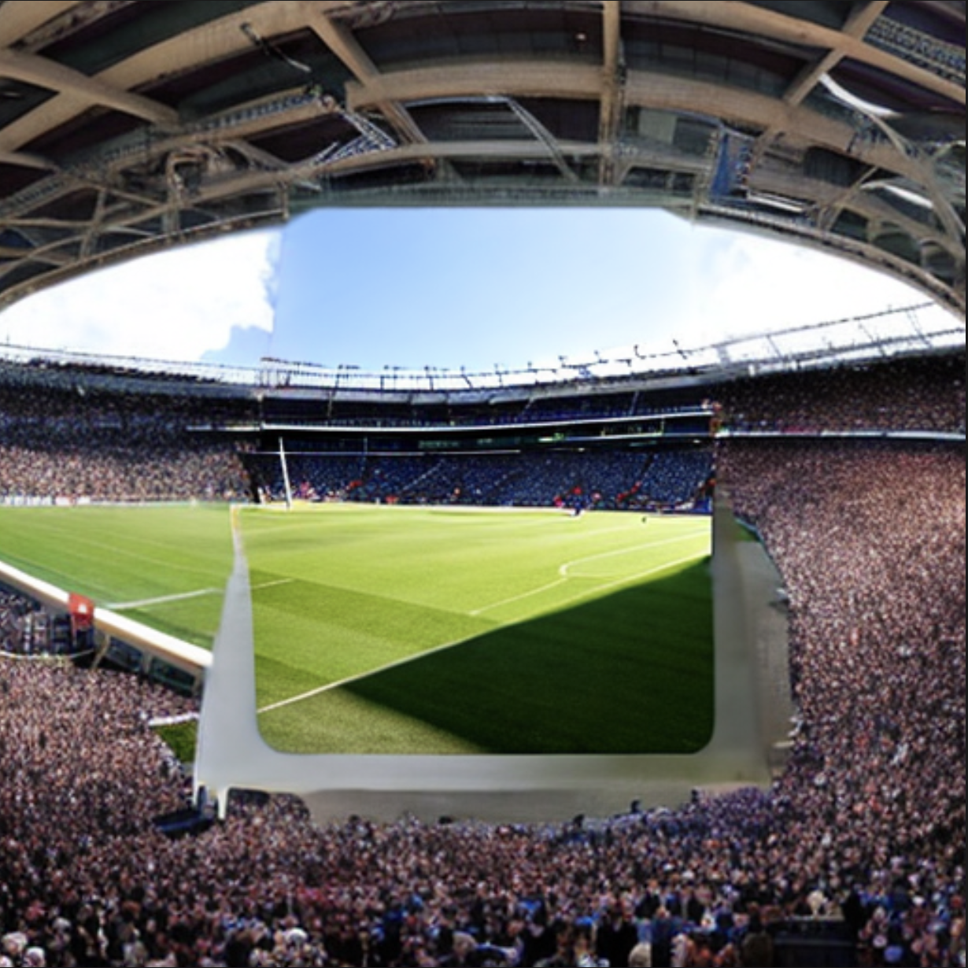
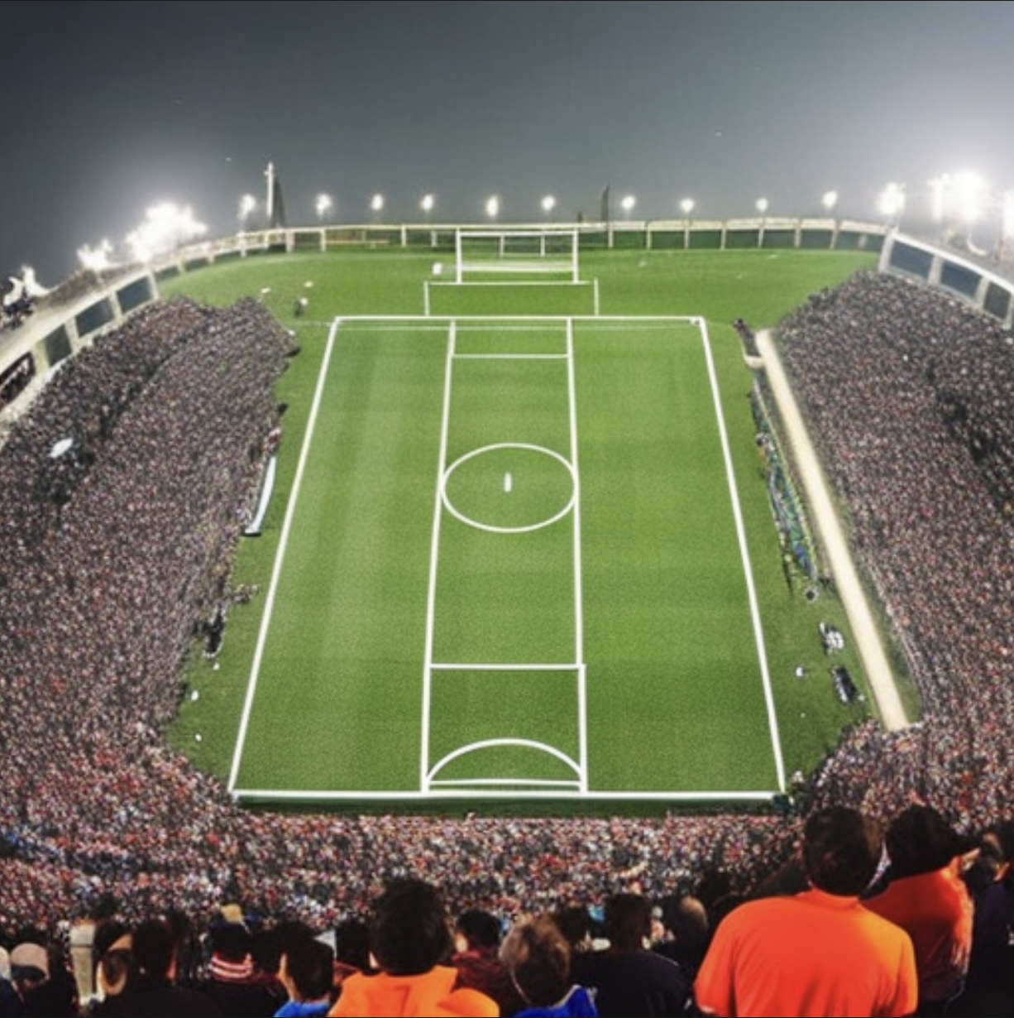
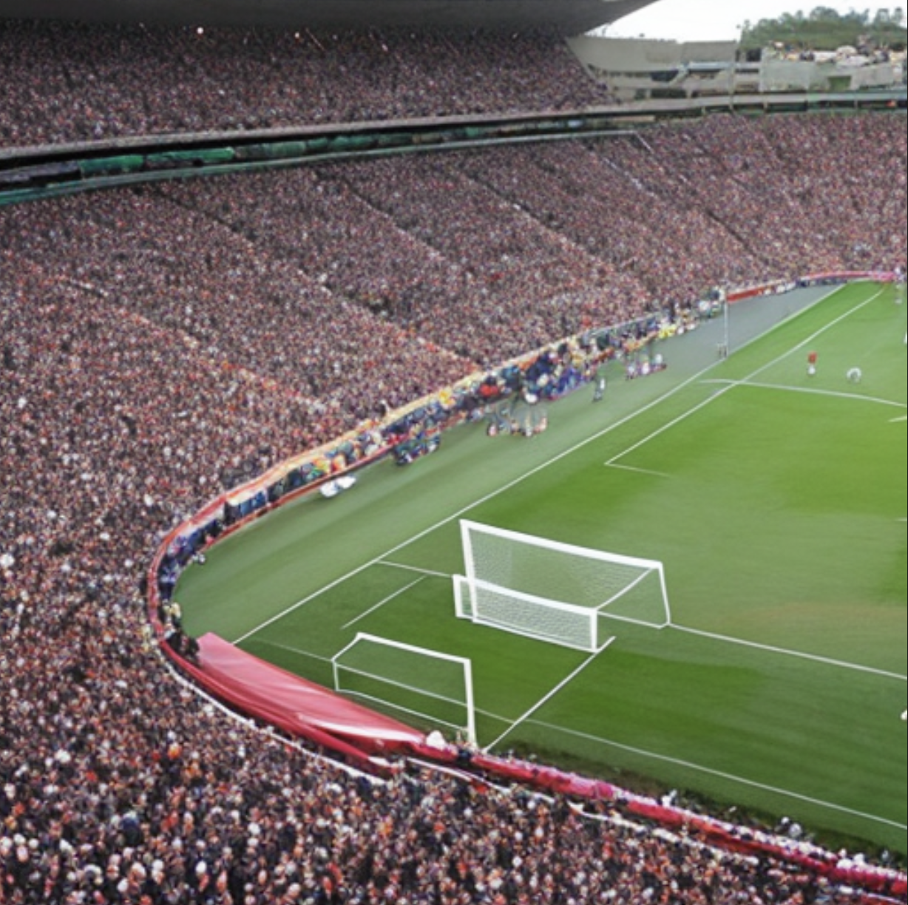

Ablation study: Why Bootstrapping works?
Bg: “A stadium holding a soccer game, full of people.”
Fg Mask: “a green field”
T_{init}= 0
T_{init}= 20
T_{init}= T_{total} =50
Tradeoff!
Global layout consistency
Local region accuracy
Notes:
To understand why bootstrapping works. We have done a experiment. We provide the model with a simple mask and prompt. Where the fg mask … the bg mask …
Here is the results of how different T_init affects generated images.
As you can see, when Tinit is 0, we are starting to add layout constraint and make the SD focus on the region very early, the model can not consider the full context in the image. This have showed unsmooth transite between the boundary and unnatural image structure. For Tinit is at the end of denoise step, we can see the content does not follow tights mask and that is because for Diffision models. the layout tent to be determined early on the diffusion process, if there is no strong guidance on the geometry layout in the early stage, it is very difficult to fix it in latter process.
So we can see, we we set Tinit to 20, it shows a good results where we have good layout and natural connection between front ground and background.
There is a tradeoff here control by Tinti, which is the balance between the global layout consistency and the local region accuracy.

Slide 33
OUR experiment: region-based + panorama
Panorama with region control
Semantic fusion
Spacial fusion
Notes:
In the paper, the author have shown two downstream tasks for the proposed paradigm: the panorama and the region based text2img generation. In the their future work, they talk about combine these two tasks together.
So We also do some experiment to see how good the model on panorama with region control. This require the model to fusion the patches both in spatial and semantic level, which increase a lot of complexity.

Slide 34
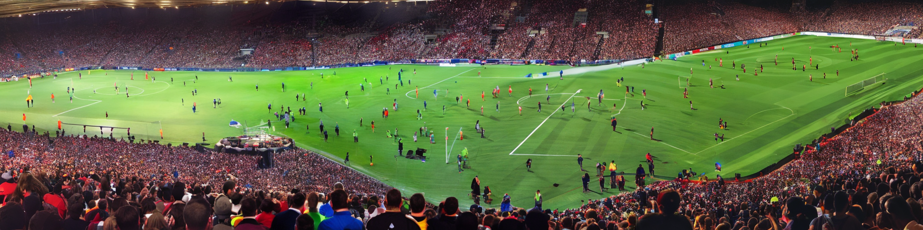
Results (only Panorama)
“A stadium holding a soccer game, full of people.”
512x2048
Notes:
We test it with a sample prompt: a stadium holding a soccer game, full of people.
This is the results of only panorama.
The resolution is 512 x2048.
The green field shape is connected but does not make any sense in semantically level. The green field should be a rectangle but it is not.

Slide 35
Φ(Fᵢ(Jₜ), y)
Analysis
“A stadium holding a soccer game, full of people.”
All sliding windows conditioned on the same text!
Notes:
What is the reason?
That is because for each of the patches, we generate them using the same text and there are not geometry constraint over these patches. So each patch will have rectangle green filed, but over all patches it is not rectangle.

Slide 36
Results (only Region based)
Bg: “A stadium holding a soccer game, full of people.”
Fg Mask: “a green field”
512x512
Notes:
Region based method can give a good solution to this problem.
Just like the example we showed before, giving a masks as region guidance, the model can have a good geometry constraint. But in a resolution 512x512.
But how well will the model work if we can use the region based generation to generative panorama images?

Slide 37
Results (region-based + panorama)
“A stadium holding a soccer game, full of people.”
Mask: “a green field”
512x2048
Notes:
Here is the result~
For this experiment, we provide the mask as the same resolution as output image and the mask will be also crop as patches when denoising.
It is a lot better compare to previous panorama, the overall layout is good.
However, there is still some inconsistency in the middle of the green field.
So follow this experiment, lets wrap up and talk about some takeaways and some limitations of this paper.

Slide 38
TakeAways
ANY/High-Resolution image generation
Training-Free paradigm
Similar to ConvNet Sliding Windows (locality!)
Limitations
Dependent on Prior Reference model
Slow inference
Semantic Consistency between different patches
Notes:
For the key takeaways,
• First, MultiDiffusion enables high-resolution image generation for any target resolution, making it highly flexible.
• Second, it follows a training-free paradigm, meaning we don’t need to retrain models to use it.
• The approach is similar to the sliding window method in convolutional neural networks, provide locality to diffusion models.
However, there are also some limitations to consider:
• The method relies on a prior reference model, which means the quality of the output depends on the model we use.Currently,we use SD2 as the pretrained prior.
• The inference time of these model is quite long as it requires referencing the Diffusion Model multiple times
• Semantic consistency are not guarantee in this pipeline, just like the green field example.

